Slide 1
Turning and Boring Processes

Slide 2
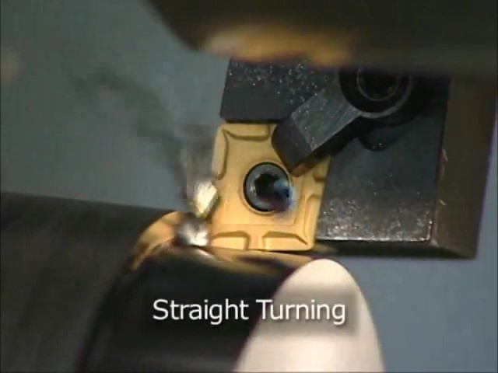
Watch Video Here
Notes:
Straight Turning

Slide 3
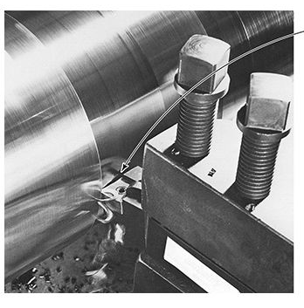
Turning Process

Slide 4
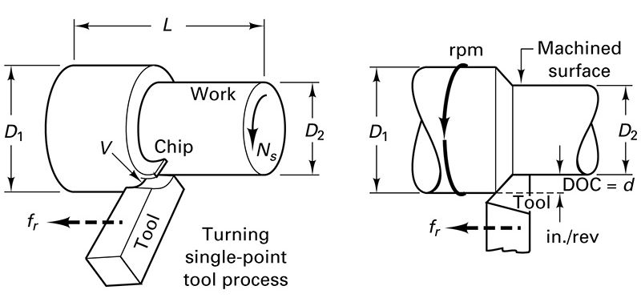
Turning Basics

Slide 5
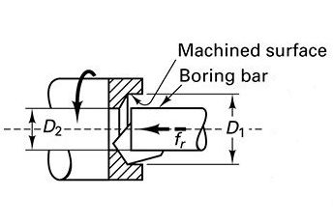
Boring Basics

Slide 6
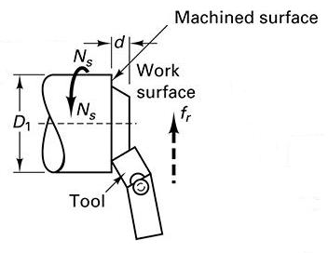
Facing Basics

Slide 7
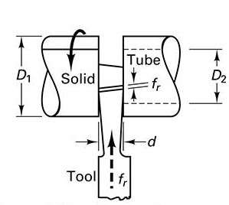
Cutoff or Parting Basics

Slide 8
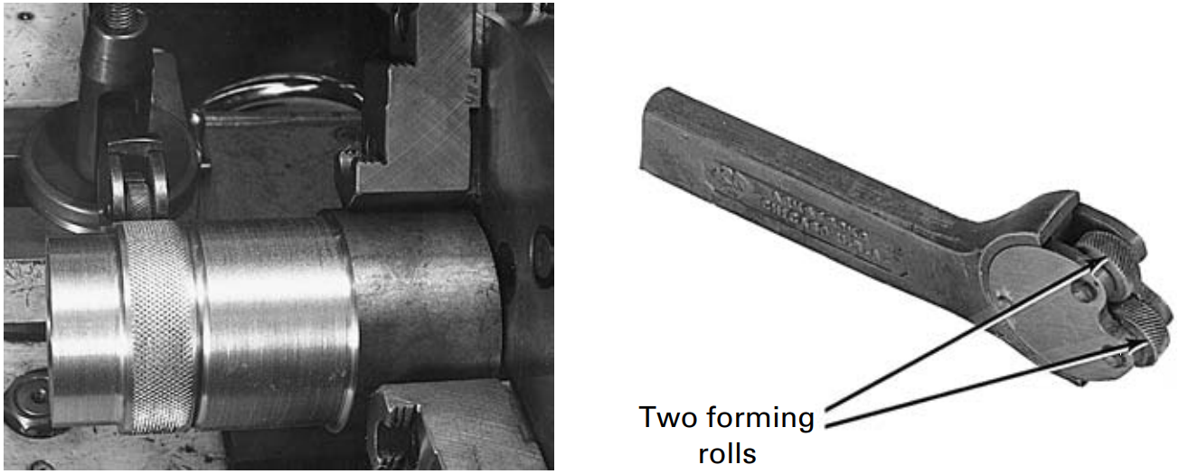
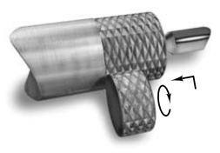
Knurling

Slide 9
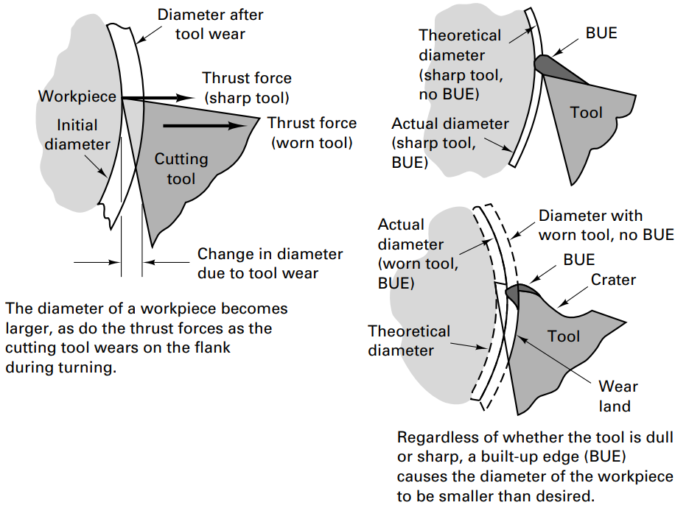
Tool Wear and BUE

Slide 10
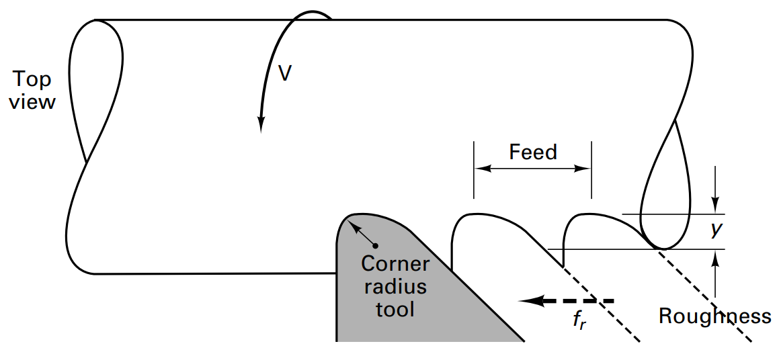
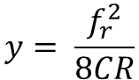
Surface Roughness and Cutting Tool Radius
$$y= \frac{f_{r}^{2}}{8CR}$$
The feed and the corner radius ($CR$) of the cutting tool influences the surface roughness.

Slide 11

Watch Video Here
Notes:
Basic Lathe Turning

Slide 12
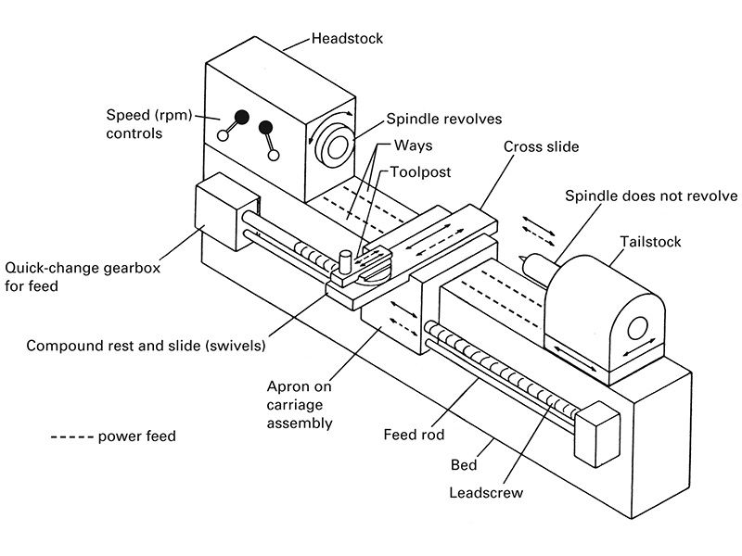
Diagram of a Lathe

Slide 13
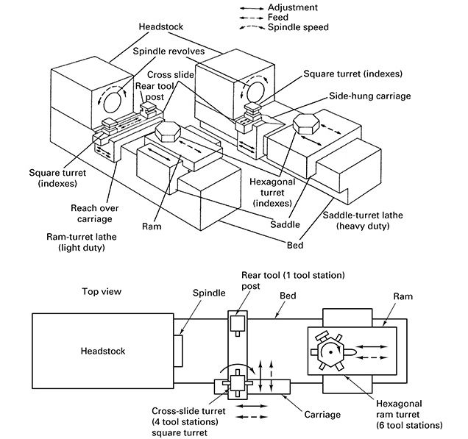
Turret Lathe

Slide 14
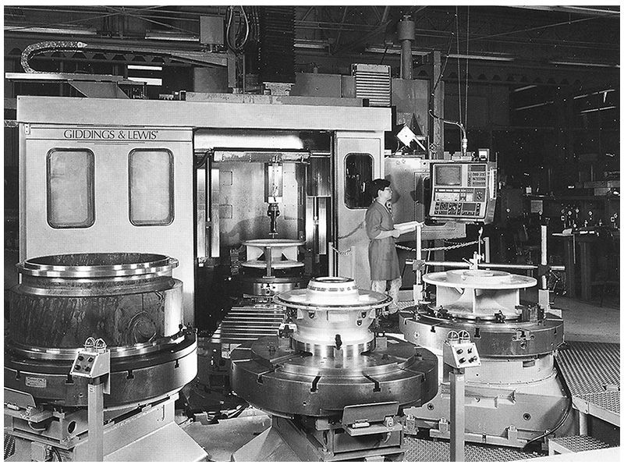
Vertical Turning Center

Slide 15
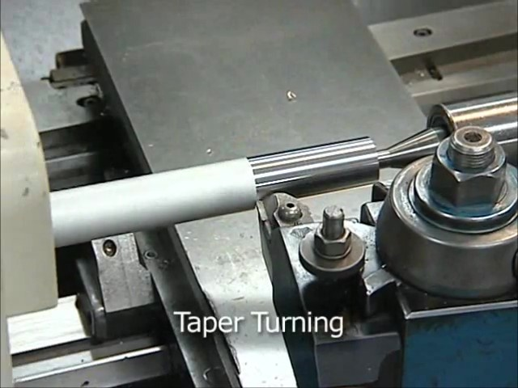
Watch Video Here
Notes:
Taper Turning

Slide 16
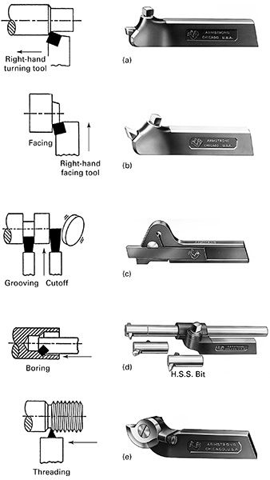
Tool Holders

Slide 17
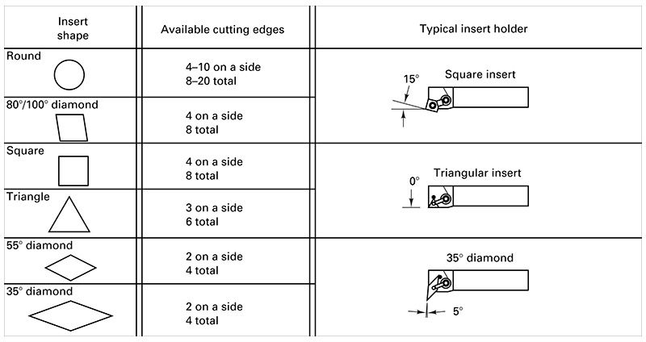
Cutting Insert Types

Slide 18
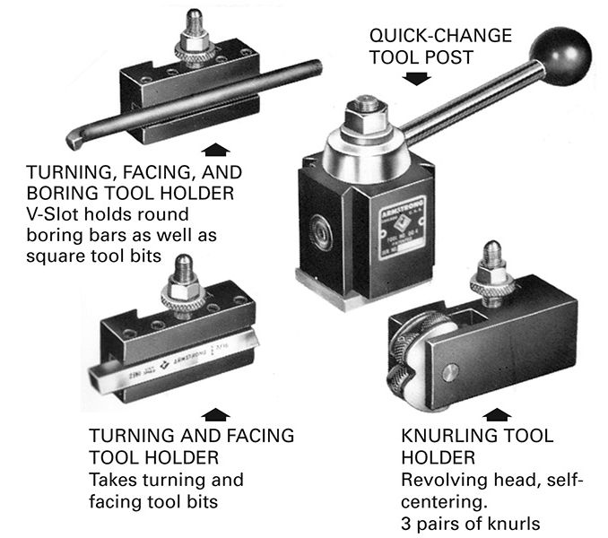
Quick-Change Tool Posts

Slide 19
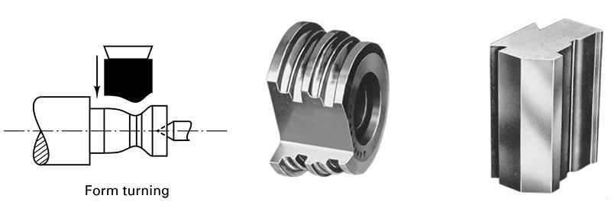
Form-cutting Tool

Slide 20
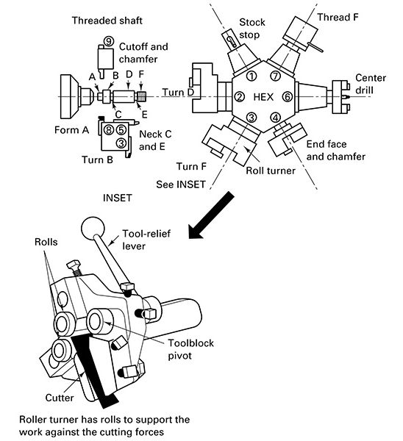
Turret Lathe Tooling

Slide 21
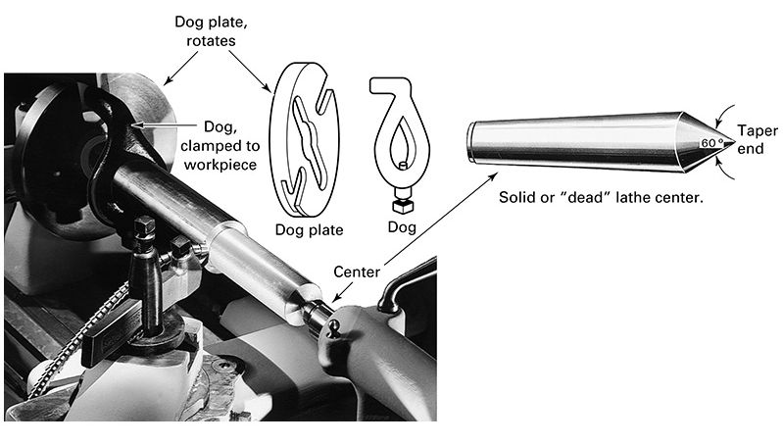
Faceplate and Dog

Slide 22
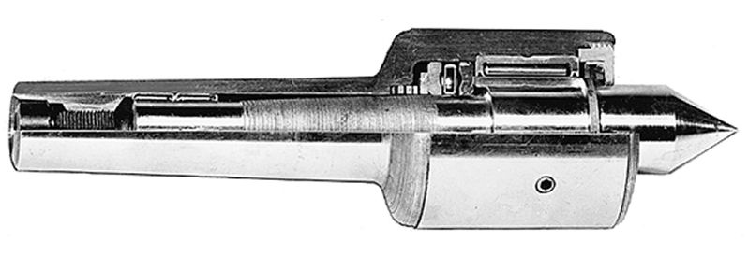
Live Center

Slide 23
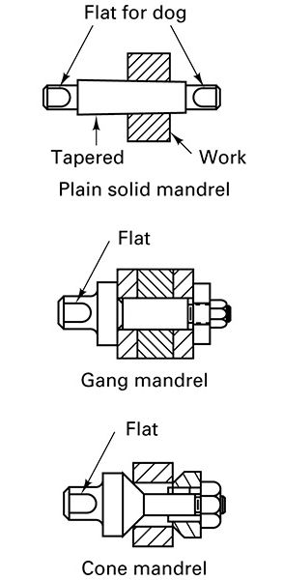
Mandrels

Slide 24
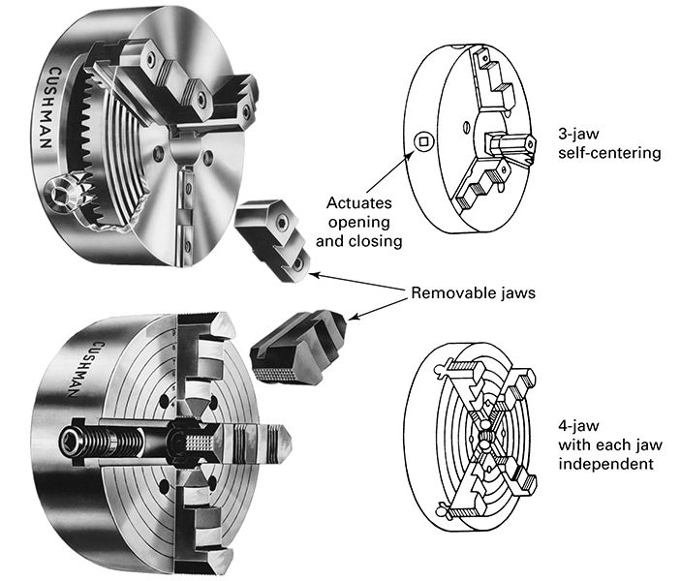
Lathe Chuck

Slide 25
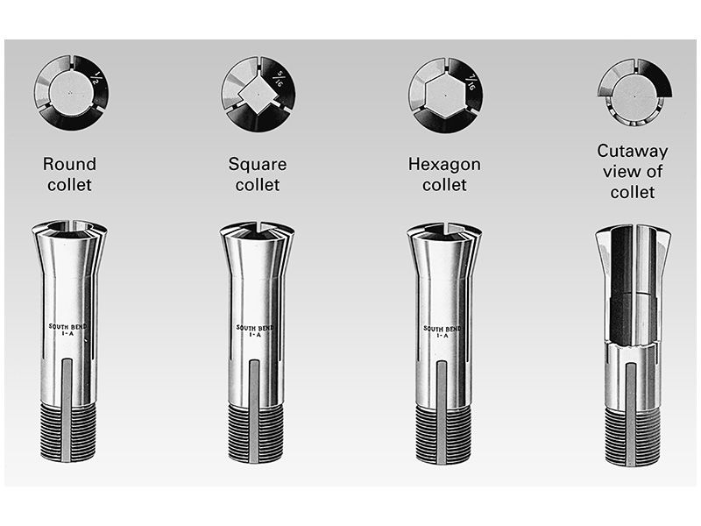
Collets

Slide 26
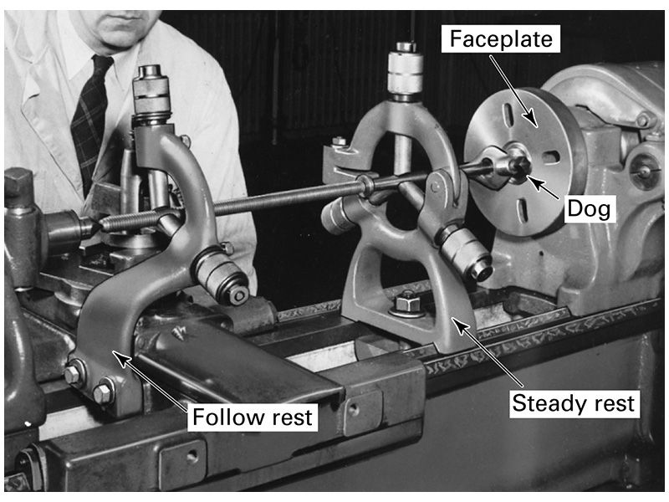
Follow and Steady Rest

